Slide 1
Batch Files and Scripts
Vic Laurie
PPCUG
June 9, 2003

Slide 2
Why Should You Care?
Many easy-to-use, helpful little programs
Psychological satisfaction of not being totally under Windows control
Not for everybody but programming can be fun
Make you better prepared to avoid viruses

Slide 3
General Program Types
Compiled
  Written in some coding language and then converted to binary
  Executable that interacts with OS directly
  Examples of languages are C and Java
Interpreted
  Text files that require an interface
    Much slower but easy to write and edit
    Generically called “scripts”

Slide 4
Common Scripts
Batch files
  An old format with new power in XP
VBScript
  Related to visual basic and VBA
JavaScript (also JScript)
  Common on Internet
  Not related to Java
Special files with REG extension
  Specifically to edit Registry

Slide 5
What are Scripts Used For?
Repetitive operations
  System administration
  Automation of common tasks
To carry out a series of operations in one step
To help with file management
To make Registry changes

Slide 6
What is a Batch File?
A text file with extension BAT containing a sequence of commands
Interpreter is command.com in DOS/Windows 9x/Me
  Commands are DOS plus some additions for variables and branching
Interpreter is cmd.exe in XP
  Available commands are more versatile than DOS and are 32-bit

Slide 7
Example of Batch File
“Cleantmp.bat”
  del C:\windows\temp\*.tmp
    Note use of wildcard “*”
More sophisticated version in XP can have switches and long file names
  del /s/q C:\windows\temp\*.tmp
Could add more lines
  To clean Internet cache, etc

Slide 8
Another Example
(Windows 9X/Me)
cd C:\windows
deltree /y temp\
deltree /y tempor~1\
deltree /y cookies\
Use “del” and “rd” in XP with /s

Slide 9
Batch Files for Clean Up
Fred Langa at
  www.langa.com/cleanup_bat.htm
  www.langa.com/newsletters/2002/
  2002-04-04.htm#2

Slide 10
For Backup
Can use “xcopy” with various switches
For example
  xcopy folder1 folder2 /d:(date)
    Date format mm-dd-yyyy
  Or xcopy folder1 folder2 /u
  Or xcopy folder1 folder2 /s/u

Slide 11
Reference for Backup Files
Fred Langa at
  www.langa.com/backups/backups.htm

Slide 12
Arguments (Placeholders)
Batch files can accept input
  Use placeholders (arguments)
xcopy %1 %2
If batch file called “backup.bat”
  Enter “backup.bat folder1 folder2” in command line
    Be careful about paths

Slide 13
A Few of the Commands
attrib
copy
del
dir
md
rd
ren
xcopy
assoc, ftype
findstr
pushd, popd
reg
shutdown
for
goto
if

Slide 14
For Help
Enter “help” in command line (not in Windows Me)
Enter “command /?” as in “xcopy /?” to obtain information on specific command
In Windows XP Pro enter “hh ntcmds.chm” in Start|Run for extensive command line help

Slide 15
Some References
http://www.microsoft.com/technet/treeview/default.asp?url=/TechNet/prodtechnol/winxppro/proddocs/batch.asp
http://www.microsoft.com/technet/treeview/default.asp?url=/technet/prodtechnol/winxppro/proddocs/ntcmds.asp

Slide 16
Scripts (VBS and JS)
Two interfaces
  Windows Script Host
    For scripts run locally
    Has access to file system and Registry
  Browser
    For scripts on Internet
    Does not have access to file system
    VBS not read by Netscape (newer version?)
Both can read and pass scripts to the scripting “engine”

Slide 17
VBScripts vs Batch Files
More oriented to user interaction
  Can be graphical or command line
Greater control of other programs
Has powerful file system functions
Can edit Registry
Object oriented
Harder to learn and program

Slide 18
Some Useful VBScripts
Increase icon cache
Scandisk and defrag all drives automatically
Clean temp files
Selectively clean “cookies”
Backup folders and files
Get product key for Windows
Change registered owner
Carry out tasks at shutdown
File association fixes
Various edits to Registry
Add to Context Menu

Slide 19
Some Sources of VBScripts
http://billsway.com/vbspage/
http://www.dougknox.com/
http://www.kellys-korner-xp.com/xp_tweaks.htm
  Over 200 tweaks for XP

Slide 20
'ScanFragAll.vbs - ScanDisk and DeFrag on all hard drives.
'© Bill James - billjames.geo@yahoo.com - rev 10 Oct 1999
Option Explicit
Dim WshShell
Set WshShell = WScript.CreateObject("WScript.Shell")
WshShell.Run "scandskw /all /n /silent",1,true
WshShell.Run "defrag /all /noprompt",1,true

Slide 21
VBScripts and Viruses
Some viruses are in form of VBScripts
Anti-virus programs may block use of scripts
OE 6 may not allow downloading of attachments with VBS (and other) extensions

Slide 22
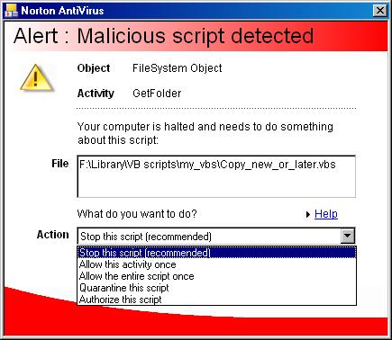

Slide 23
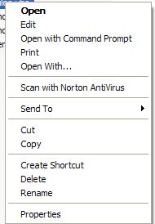

Slide 24
JavaScript and JScript
Extensively used on Web pages
  Hit counters, today’s date, etc
  Whole libraries of scripts available for buddingWebmasters
Not used as much for local computers

Slide 25
Bookmarklets
http://www.bookmarklets.com/
Very short JavaScripts that can be added to Favorites
Add useful functions to browser

Slide 26
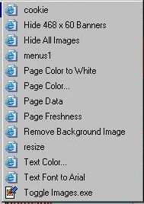

Slide 27
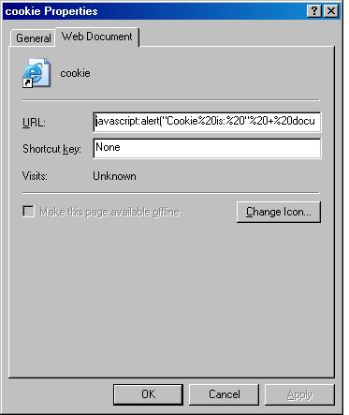

Slide 28
“REG” Files
Special text files with extension REG
Double-clicking modifies a section of the Registry
Can add, delete, or modify keys and values
Can download useful Registry tweaks

Slide 29
    REGEDIT4
    [HKEY_LOCAL_MACHINE\Software\Microsoft\Windows\CurrentVersion\explorer]
    "Max Cached Icons"="4096"

Slide 30
    Windows Registry Editor Version 5.00
    [HKEY_LOCAL_MACHINE\SOFTWARE\Classes
    \AllFilesystemObjects\shellex]
    [HKEY_LOCAL_MACHINE\SOFTWARE\Classes
    \AllFilesystemObjects\shellex\ContextMenuHandlers]
    [HKEY_LOCAL_MACHINE\SOFTWARE\Classes
    \AllFilesystemObjects\shellex\ContextMenuHandlers\Copy To]
    @="{C2FBB630-2971-11D1-A18C-00C04FD75D13}"
    [HKEY_LOCAL_MACHINE\SOFTWARE\Classes
    \AllFilesystemObjects\shellex\ContextMenuHandlers\Move To]
    @="{C2FBB631-2971-11D1-A18C-00C04FD75D13}"
    [HKEY_LOCAL_MACHINE\SOFTWARE\Classes
    \AllFilesystemObjects\shellex\ContextMenuHandlers\Send To]
    @="{7BA4C740-9E81-11CF-99D3-00AA004AE837}"

Slide 31
Sources of REG Files
http://www.aumha.org/regfiles.htm
http://home.satx.rr.com/badour/html/reg_files.html
http://www.kellys-korner.com/registry_fixes.htm

